Slide 1
A core Course on Modeling
Introduction to Modeling
0LAB0 0LBB0 0LCB0 0LDB0
c.w.a.m.v.overveld@tue.nl
v.a.j.borghuis@tue.nl
P.13

Slide 2
Investigating the behavior of a functional model:
The analysis tools in ACCEL.
The tools on the analysis-tab
Condition numbers, sensitivity and error propagation
An example

Slide 3
Investigating the behavior of a functional model:
The tools on the analysis tab.

Slide 4
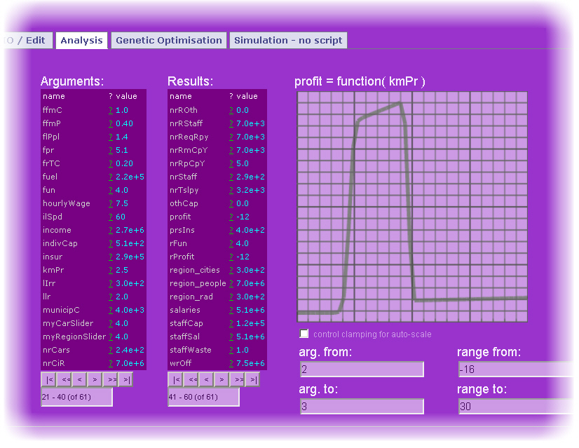
Investigating the behavior of a functional model:
The tools on the analysis tab.
Select a quantity that should serve as argument from the list of quantities
Select a quantity that should serve as result from the list of quantities
If necessary, scroll through the list of quantities in the model
If necessary, scroll through the list of quantities in the model
If necessary, adjust lower and upper bounds of the argument
If necessary, adjust lower and upper bounds of the result
The dependency is graphically plotted

Slide 5
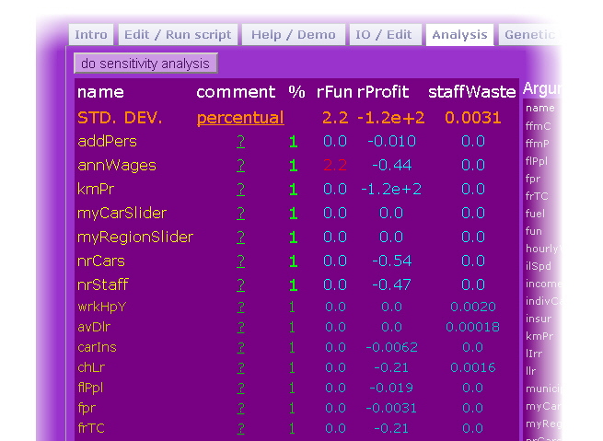
Investigating the behavior of a functional model:
The tools on the analysis tab.
Request a sensitivity analysis by clicking this button.
Choose between absolute or relative(=percentual) analysis.
By default, the stepsize used for the numerical approximation is 1(%). If necessary, adjust this value.
One column for each cat.-II quantitiy , giving the condition number or the absolute uncertainty.
The top row holds the (abs. or perc.) standard deviation of this cat.-II quantity.
The condition number or uncertainty.

Slide 6
Investigating the behavior of a functional model:
Sensitivity, condition numbers and error propagation.
Consider the functional model
y = f(x₁, x₂) = x₁*x₂.
If each of the cat.-I quantities (x₁, x₂) has an uncertainty of 1%, what is the relative uncertainty in cat.-II quantity y?
→ condition numbers

Slide 7
Investigating the behavior of a functional model:
Sensitivity, condition numbers and error propagation.
Relative uncertainty = δy/y.
y = f(x₁, x₂) = x₁*x₂.
δy = ∂f/∂x₁ δx₁ + ∂f/∂x₂ δx₂

Slide 8
Investigating the behavior of a functional model:
Sensitivity, condition numbers and error propagation.
Relative uncertainty = δy/y.
y = f(x₁, x₂) = x₁*x₂.
δy = ∂f/∂x₁ δx₁ + ∂f/∂x₂ δx₂

Slide 9
Investigating the behavior of a functional model:
Sensitivity, condition numbers and error propagation.
Relative uncertainty = δy/y.
y = f(x₁, x₂) = x₁*x₂.
δy = ∂f/∂x₁ δx₁ + ∂f/∂x₂ δx₂
= x₂ δx₁ + x₁ δx₂
δy/y = ( x₂ δx₁ + x₁ δx₂ )/ x₁x₂

Slide 10
Investigating the behavior of a functional model:
Sensitivity, condition numbers and error propagation.
Relative uncertainty = δy/y.
y = f(x₁, x₂) = x₁*x₂.
δy = ∂f/∂x₁ δx₁ + ∂f/∂x₂ δx₂
= x₂ δx₁ + x₁ δx₂
δy/y = ( x₂ δx₁ + x₁ δx₂ )/ x₁x₂ = δx₁/x₁ + δx₂/x₂
both condition numbers are 1.
δy/y = rel. uncertainty in x₁ + rel. uncertainty in x₂ ...
... if they would simultaneously assume their extremes.

Slide 11
Investigating the behavior of a functional model:
Sensitivity, condition numbers and error propagation.
So δy/y = δx₁/x₁+ δx₂/x₂ (both condition numbers =1)
= rel. uncertainty in x₁ + rel. uncertainty in x₂ ...
... if they would simultaneously assume their extremes.
If x₁ and x₂ are uncorrelated, however, we use
(δy/y)² = (δx₁/x₁)²+ (δx₂/x₂)² – or in general
(δy/y)² = c₁²(δx₁/x₁)²+ c₂²(δx₂/x₂)².
For c₁=c₂=1, we get with δx₁/x₁=1%, δx₂/x₂=1% that δy/y=1.41 %,
and rel. uncertainties of x₁ and x₂ have equal impact.

Slide 12
Investigating the behavior of a functional model:
Sensitivity, condition numbers and error propagation.
Compare this with
y = f(x₁, x₂) = x₁*x₂²;
then
c₁ = ∂f/ ∂x₁* x₁/y = x₂² * x₁/(x₁x₂²) = 1
c₂ = ∂f/ ∂x₂* x₂/y = 2x₁x₂ * x₂/(x₁x₂²) = 2
So if both x₁ and x₂ have equal relative uncertainty, the uncertainty in x₂ has twice as much impact.

Slide 13
Investigating the behavior of a functional model:
Sensitivity, condition numbers and error propagation.
In general: for models of the form (so called multiplicative forms)
y = f(x₁, x₂, x₃, ...) = f(x_{i}) = Π_{i}x_{i}^{mi}, the |condition number| is |m_{i}|.
In other words: for multiplicative models,
the higher the |exponent| of x_{i}, the larger the impact of relative uncertainty in x_{i} .
this impact is constant throughout the entire domain (=does not depend on the values of the cat.-I or cat.-III quantities)
Remember the detergent problem, the chimney sweepers problem and many others: such models occur very often.

Slide 14
Investigating the behavior of a functional model:
Sensitivity, condition numbers and error propagation.
For additive models:
y=f(x_{i}) = Σ_{i} a_{i} x_{i}
δy = ∂y/∂x δx = a_{i} δx.
In other words: for additive models,
the higher the |factor| for x₁, the larger the impact of absolute uncertainty in x₁.
this impact is constant throughout the entire domain (=does not depend on the values of the cat.-I or cat.-III quantities)

Slide 15
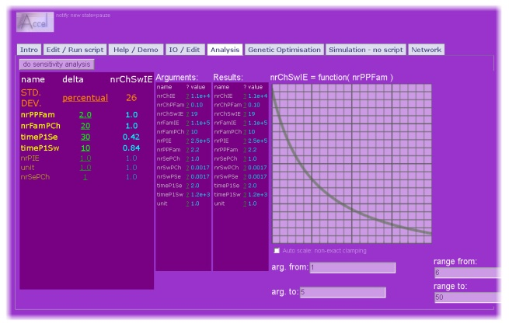
Investigating the behavior of a functional model:
An example: the chimney sweepers’ case.
nr. chimney sweepers in Eindhoven decreases as a function of the family size

Slide 16
Investigating the behavior of a functional model:
An example: the chimney sweepers’ case.
rel. uncertainty in family size: 2% (good statistics)

Slide 17
Investigating the behavior of a functional model:
An example: the chimney sweepers’ case.
rel. uncertainty in nr. families per chimney: 20% (poor statistics)

Slide 18
Investigating the behavior of a functional model:
An example: the chimney sweepers’ case.
rel. uncertainty in sweeping time per chimney per chimney: 30% (poor statistics)

Slide 19
Investigating the behavior of a functional model:
An example: the chimney sweepers’ case.
rel. uncertainty in annual working time per sweeper: 10% (good statistics)

Slide 20
Investigating the behavior of a functional model:
An example: the chimney sweepers’ case.
resulting rel. uncertainty in number of sweepers in Eindhoven: 26%

Slide 21
Investigating the behavior of a functional model:
An example: the chimney sweepers’ case.
The details:
The chimney sweepers’model is a multiplicative model. All condition numbers are 1; there are 7 quantities. Expected rel. uncertainty for all 1% uncertainties is therefore √7 = 2.64.
ACCEL gives 2.4 instead; this is because nrFamPCh is an all-integer slider; therefore condition number is not computed.

Slide 22
Summary:
A functional model is all about dependencies.
Graph plotting helps ascertain that dependencies are plausible.
Input quantities (cat.-I, III) have uncertainties. These propagate into an uncertainty in the answer.
Absolute uncertainties: δy;
Relative uncertainties: δy/y;
ACCEL numerically estimates error propagation
and the expected uncertainty in the cat.-II quantities.

